Slide 1


College of Engineering
PUNE DISTRICT EDUCATION ASSOCIATION’S
Manjari (BK'), Pune.
Department Of Computer Engineering
Topic Name
Name :- Virtual Laboratory for Chemical Experiments
Team id :- 4026 Project Guide :- Prof.B.A.Bhamnikar
Team Members :-
1.Rutuja Pandurang Kolate 173
2.Piyush Kasture 1
3. Ayush Arun jogi 254
4.Rushi Prakash Joshi 253

Slide 2
TABLE OF CONTENTS :-
1.Problem Statement
2.Abstract
3.Introduction
4.Motivation
5.Liturature Survey
6.Software Hardware Requirement
7.Sponsership Letter
8.Reference

Slide 3
Problem Statement
How can a virtual laboratory be developed to effectively simulate real-world experiments, providing an interactive and accessible learning environment for students? The goal is to enhance educational experiences by offering realistic, cost-effective, and scalable lab simulations that integrate seamlessly with existing curricula and support diverse learning needs.

Slide 4
ABSTRACT
Our Virtual Laboratory is like bringing a real science lab to your computer screen. Students can do experiments anytime and anywhere, just by using the internet. Instead of waiting for lab time at school, they can try chemistry, physics, and other science experiments safely from home. If they make mistakes, they can simply restart and try again without any risk. This helps students learn better because they can practice as many times as they want. The project is especially helpful for students who can't reach physical labs or schools that can't afford expensive lab equipment. It's just like playing an educational game, but one that teaches real science through hands-on virtual experiments.

Slide 5
INTRODUCTION
In science and engineering education, practical lab experience is essential, yet physical distances and limited resources often prevent students from accessing required laboratories—especially those with specialized, costly equipment. Traditional online resources, like video-based courses, help convey theoretical concepts but lack the hands-on experience crucial for learning. This gap highlights the limitations of the current system, which restricts access due to geographic and financial constraints, high operational costs, and safety concerns associated with certain experiments. Virtual labs address these challenges by offering remote access to simulated lab environments, enabling students at all levels to conduct experiments, explore scientific principles, and develop practical skills in a scalable, safe, and cost-effective manner.

Slide 6
MOTIVATION
Virtual labs revolutionize the learning experience, particularly for students who face challenges in accessing traditional lab environments. By providing immersive 3D visualizations, students struggling to grasp complex concepts like chemical reactions can witness these processes in detail and repeat them as needed, enhancing comprehension in ways that limited time in physical labs cannot. Virtual labs also break down accessibility barriers, allowing students from rural or underserved areas to perform sophisticated experiments online and enabling differently-abled students to learn without physical limitations. Furthermore, virtual labs offer a safe environment for exploring high-risk experiments, letting students practice without danger and develop confidence in handling advanced procedures. This approach also minimizes the risk of costly equipment damage, empowering students to learn through trial and error without the fear of real-world consequences. Virtual labs not only make learning more accessible and safer but also foster a hands-on, risk-free environment where students can grow and excel.

Slide 7
LITERATURE SURVEY
Sr. No . | Author & Year | Title Of Paper | Techniques Used | Observations | Identified Issues
1. | Anthony Khoury in 2023 | Educational Applications on Smartphone for virtual Laboratories in Engineering | Simulation-based Learning, Sensor Integration and Data Acquisition
2. | Raul Castilla-Arquillo in 2024 | Virtual Reality Lab for Rover Navigation using Mars datasets | Super-Resolution GAN(SRGAN) and YOLOv5 Neural Network
3. | Josefina Castillo Reyna in 2023 | Virtual Journey and Virtual Bio-Labs

Slide 8
LITERATURE SURVEY
Sr. No . | Author & Year | Title Of Paper | Techniques Used | Observations | Identified Issues
1. | Ishant Singhal in 2024 | 3D-Printing Virtual Simulation Lab. | Virtual Simulation of 3D Printing Process, Interactive 3D Modelling Tools
2. | Mihir Jain in 2024 | Virtual Reality in Electronics and communications Engineering Education | 3D modeling ad simulations, Interactive Learning Environments, Immersive Training
3. | Mengjiao Lu in 2023 | Research on the Application of Virtual Teaching Systems, in Experimental and Practical Teaching Based on CiteSpace Visual Anaylsis | Bibliometric Visualization and analytic Hierarchy Process(AHP)

Slide 9
Software and Hardware Requirements
Software Requirements :
Frontend: React Native or Flutter
Backend: Node.js (Express) or Django
3D Simulation: Unity3D/Unreal for VR or Three.js for WebGL
Database: MySQL/PostgreSQL or MongoDB
Cloud & API: AWS/Azure; WebRTC/Socket.io for real-time collaboration
Testing & Deployment: Jest/Cypress; CI/CD with GitHub Actions
Dev Environment: Visual Studio Code; GitHub for version control
Hardware Requirements:
Development Machine: 16GB RAM, multi-core processor, SSD, dedicated GPU if using VR/AR
Mobile Devices: iOS and Android for testing; VR headset if needed
Server: High-performance cloud servers with GPU if needed

Slide 10
RESEARCH GAP
While virtual labs are revolutionizing education by making high-risk experiments safe and accessible for students worldwide, there are still several areas where research is needed to optimize their impact. First, understanding the effectiveness of virtual labs in achieving long-term learning outcomes compared to traditional labs remains limited, particularly concerning skills like critical thinking and problem-solving. Accessibility also presents a research gap, as tools for differently-abled students could be further developed to ensure inclusivity for all. Further studies could examine the development of assessment frameworks specifically suited to virtual lab environments and explore best practices for integrating virtual labs into diverse educational systems, especially in resource-limited settings. Other areas requiring exploration include understanding student perceptions and engagement strategies to address any tactile experience gaps, performing cost-benefit analyses, and conducting longitudinal studies to determine if skills learned in virtual environments transfer well to physical lab work. Addressing these gaps could refine virtual labs, making them even more effective and accessible learning tools.

Slide 11
Strength and Concerns
Strengths :-
-Facilitates interesting and immersive interaction between teachers and
students.
-Inclusive for students with disabilities or those in remote locations.
-Accessible from anywhere with an internet connection and lower costs
compared to maintaining physical labs.
Concerns:-
-Ensuring that universities are willing to adopt and regularly use the new
tool.
-Access and Infrastructure.
-Technical Support and Maintenance

Slide 12
Sponsership Letter

Slide 13
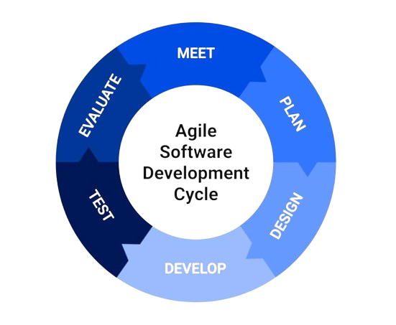
Agile Development Life Cycle

Slide 14
Meet (Planning/Requirements Gathering)
Conduct meetings with stakeholders to define the app’s goals, core features, and user needs, focusing on high-priority functionalities like virtual lab simulations, accessibility, and cross-platform compatibility.
Define the project scope, budget, timeline, and team roles.
Gather and document user stories to guide future development.

Slide 15
Reference
-https://virtualkidslab.basf.com/
-https://829299.mobirisesite.com/

Slide 16





